Slide 1
PDF and Video Practice
Create Performance Task

Slide 2

AP CSP Create Performance Task
Part of the AP Exam is to create a program that meets specific requirements:
Creates a list
Uses a list in a meaningful way
Has a function with a parameter
  Parameter affects function execution
Function has:
  If statement
  Loop

Slide 3
AP CSP Create Performance Task
After you create your program, you will submit three things in the digital portfolio:
A PDF of your entire code (including comments)
A short video (< 1 minute) of your code working
A Personal Project Reference (PPR) that contains four code segments of the code
This lesson will focus on the the first two submissions: the code PDF and the video.

Slide 4
AP CSP Create PT Code PDF
The first thing you will submit in the digital portfolio is a PDF of the entire code. We will go over:
What to include in your code PDF
What not to include in your code PDF
NOTE: This part must be completed individually and independently, even if you work with a partner on the project.

Slide 5
AP CSP Create PT Code PDF
Things to include:
A comment section at the top for code attribution.
If you use code from the Internet, your teacher, AI, or anything else you did not write yourself, you must give them credit.
You can do that with a comment block at the top of your code.

Slide 6
AP CSP Create PT Code PDF
Things to include:
If you use code that anyone (or AI) created, you need to give them credit.
At the beginning of the code segment or function, include a comment.
It can be something like this:
# Code created by …
If all of your code is original, you don’t need to worry about this!
See statement from the College Board on next slide.

Slide 7
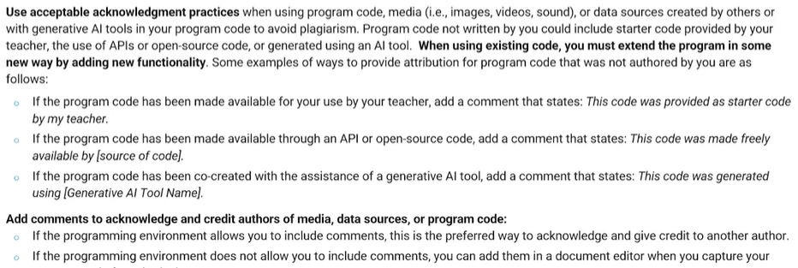
AP CSP Create PT Code PDF
From the student handout:

Slide 8
AP CSP Create PT Code PDF
Things to NOT do:
Your name – or partner’s name – anywhere in any comment.
Make the font too small. Font size 10 is the minimum.
Double-space the code.

Slide 9
AP CSP Create PT Code PDF
Here are three ways you can save your code as a PDF file:
Use AP PT CodePrint
Use a Google Doc
Use Microsoft Word
Each way is specified on a following slide.
My suggestion is to use AP PT CodePrint.

Slide 10
AP CSP Create PT Code PDF
No matter how you save the code as a PDF, remember these things:
Save the PDF in a location where you can find it.
You should be able to open the PDF and review it.
You will upload the final PDF to your digital portfolio.

Slide 11
AP CSP Create PT Code PDF
AP PT CodePrint
This free internet source will keep code colors and give line numbers for the code.
Copy the code from CodeSpace.
Paste the code into the top rectangle.
The PDF file will display below the rectangle.
Click PRINT.
Then click SAVE.
Give your file a name and select where you want to save the file.
Click SAVE.

Slide 12
AP CSP Create PT Code PDF
Google Doc
Open a new Google Doc.
Go to Page Setup and change the margins to 0.5 or smaller.
Click the “Line and Paragraph Spacing” icon.
Set the line spacing to 1 and no spacing before or after.
Paste the code into the document.
It is okay if it is more than one page.
Select a font and font size (at least 10).
Go to File → Download and choose PDF document (.pdf)

Slide 13
AP CSP Create PT Code PDF
Microsoft Word
Open a new Word document.
Go to LAYOUT and change the margins to NARROW.
The spacing before and after need to be 0.
You can add line numbers.
Paste the code into the document.
It is okay if it is more than one page.
Select a font and font size (at least 10).
Go to File → Export and choose Download as PDF.

Slide 14
AP CSP Create PT Code PDF
Time to practice
Go to the Sandbox in CodeSpace.
Open the PT_CodeBot_Practice1 program.
Choose your method for creating a PDF.
You should be able to open the PDF and review it.
Submit your practice PDF using your LMS, like Google Classroom, Microsoft Teams, or Canvas.
(Do not upload to the Digital Portfolio.)

Slide 15
AP CSP Create PT Code PDF
More practice!
Select two more practice PT programs.
For each one:
  Go to the Sandbox in CodeSpace.
  Open the program.
  Repeat the steps for creating a PDF of the code.
  Submit the practice PDF using your LMS.

Slide 16
AP CSP Create PT Video
The second thing you will submit in the digital portfolio is a video of your code running. We will go over:
What to include in your video
What not to include in your video
NOTE: This part must be completed individually and independently, even if you work with a partner on the project.

Slide 17
AP CSP Create PT Video
From the student handout:
Video requirements:
Your video:
must be either .mp4, .wmv, .avi, or .mov format
must not exceed 1 minute in length; and
must not exceed 30MB in file size.

Slide 18
AP CSP Create PT Video
Things to do:
Keep the video short.
  You do not need to include every aspect of your program.
  10-20 seconds is usually long enough.
If possible, start recording at the beginning of the program.
  You need to show input, like the button press.
  You need to show output, like the ‘bot moving, the LEDs, or the speaker beeps.
Use a stand for the camera.
  If the recording device is hands-free, you can run the program on the CodeBot.

Slide 19
AP CSP Create PT Video
Things to NOT do:
Don’t talk during the recording.
  You don’t want to be identified by your voice.
Avoid background noise.
  If you aren’t using the CodeBot speaker, turn off the recording sound.
  Record in a quiet place.
Don’t get help with what to record. That is on you!
  But if you need someone to hold the camera, or run the program on the CodeBot, that is okay.

Slide 20
AP CSP Create PT Video
You can use any recording device to shoot the video:
Cell phone camera
Document camera
Digital camera set to video
If needed, you can edit the video with software. You can add captions to explain input and/or output. But if your video is good, you shouldn’t need to.

Slide 21
AP CSP Create PT Video
Time to practice!
Go to the Sandbox in CodeSpace. Open PT_CodeBot_Practice3.
Use a recording device to record the program on your CodeX.
  Load the program on CodeBot. Then you can unplug the ‘bot and you don’t need the computer.
  This is for practice, so background noise is okay.
  Keep the video short - 10 to 20 seconds.
  Check the format of the video and the size of the video.
  Does it meet the requirements?

Slide 22
AP CSP Create PT Video
You should be able to open the video and review it.
For your Create PT project, you will upload a final video to your digital portfolio.
Submit the practice video using your LMS, like Google Classroom, Microsoft Teams, or Canvas.

Slide 23
AP CSP Create PT Video
More practice!
Select one more practice PT program.
Then:
  Go to the Sandbox in CodeSpace.
  Open the program.
  Repeat the steps for creating a video.
  Submit the practice video using your LMS.

Slide 24
AP CSP Digital Portfolio
You will submit three components to the Digital Portfolio
Do you remember your user name?
Do you remember your password?
Can you access the digital portfolio?
Practice all these things before you begin!
You will first upload a draft of each one.
After reviewing your submissions, you must click “FINAL SUBMIT” for your submissions to be accepted.
This takes time. Don’t wait until the last minute!

